Slide 1


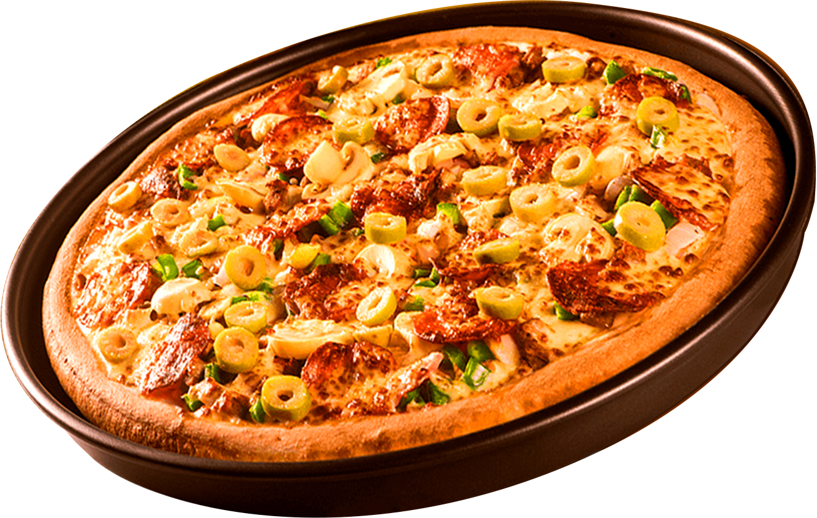
PIZZA SALES ANALYSIS
USING SQL
Start Your Slide

Slide 2
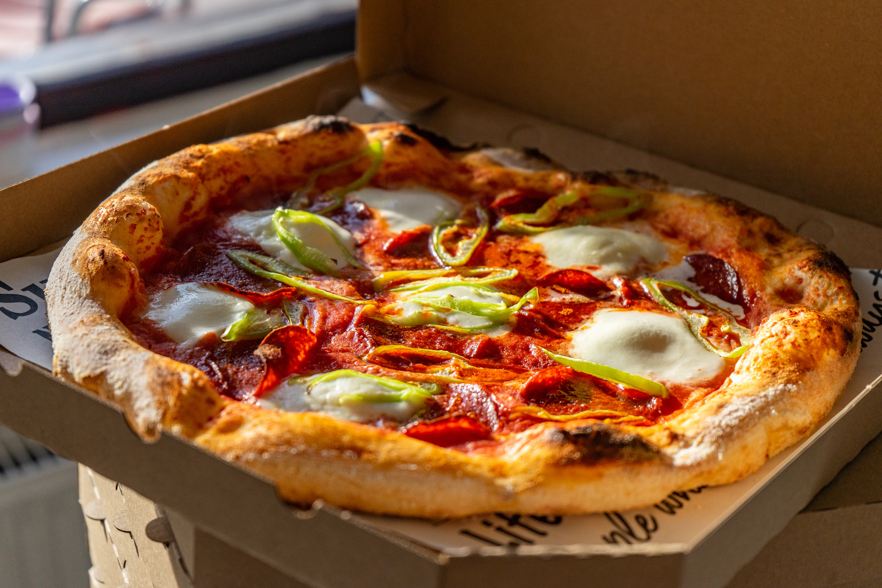
DATASETS
Short Info About Datasets
order_details
: order_details_id, order_id, pizza_id, quantity
orders
: order_id,order_date, order_time
pizza_types
: pizza_type_id, name, category, ingredients
pizzas
: pizza_id, pizza_type_id, size, price

Slide 3
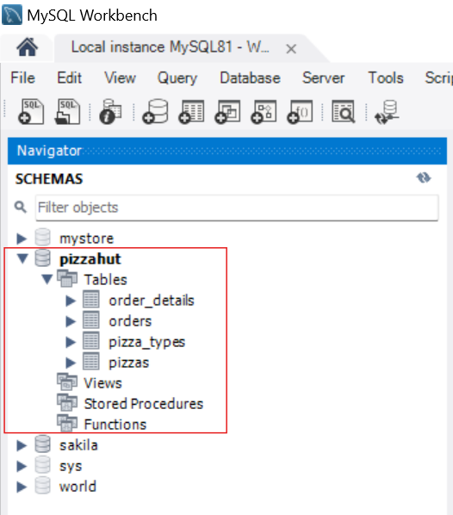
PERFORMED DATA ANALYSIS :
MY SQL WORKBENCH
Importing Datasets

Slide 4

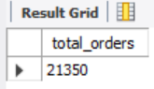
RETRIEVE THE TOTAL NUMBER OF ORDERS PLACED

Slide 5
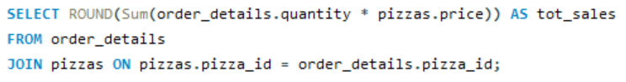
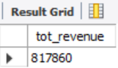
CALCULATE THE TOTAL REVENUE GENERATED FROM PIZZA SALES

Slide 6
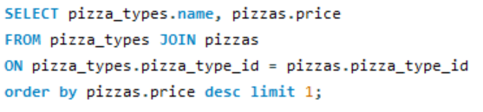
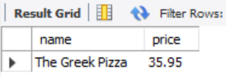
IDENTIFY THE HIGHEST-PRICED PIZZA

Slide 7
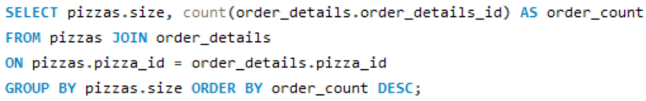
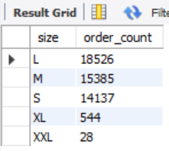
IDENTIFY THE MOST COMMON PIZZA SIZE ORDERED

Slide 8
RETRIEVE THE TOTAL NUMBER OF ORDERS PLACED

Slide 9
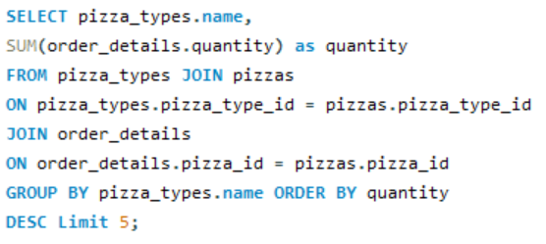
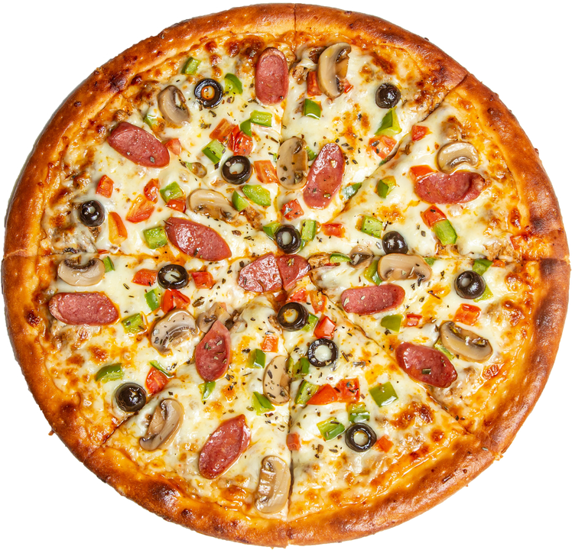
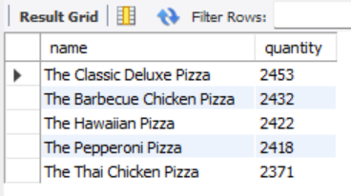
LIST THE TOP 5 MOST ORDERED PIZZA TYPES along with their quantities

Slide 10
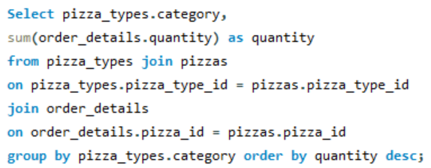
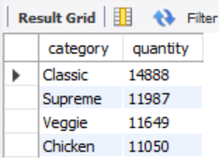
JOIN THE NECESSARY TABLES TO FIND THE TOTAL QUANTITY OF EACH PIZZA CATEGORY ORDERED.

Slide 11
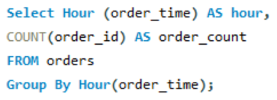
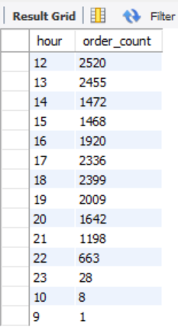
DETERMINE THE DISTRIBUTION OF ORDERS BY HOUR OF THE DAY

Slide 12
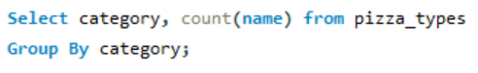
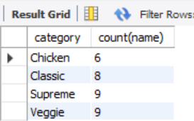
JOIN RELEVANT TABLES TO FIND THE CATEGORY-WISE DISTRIBUTION OF PIZZAS

Slide 13
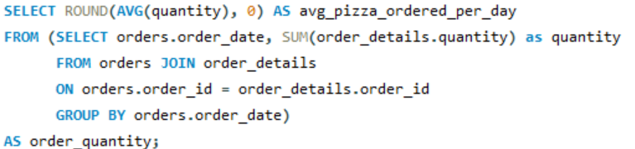
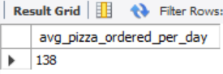
GROUP THE ORDERS BY DATE AND CALCULATE THE AVERAGE NUMBER OF PIZZAS ORDERED PER DAY

Slide 14
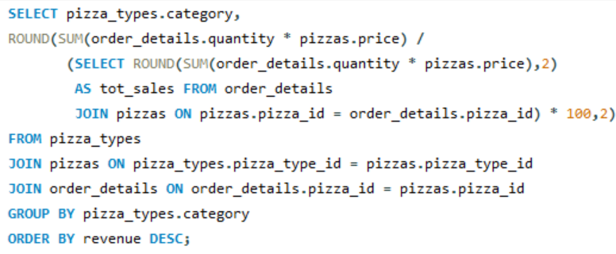

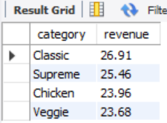
CALCULATE THE PERCENTAGE CONTRIBUTION OF
EACH PIZZA TYPE TO TOTAL REVENUE

Slide 15
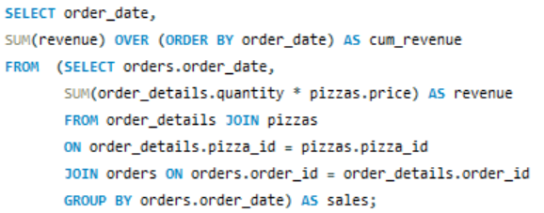
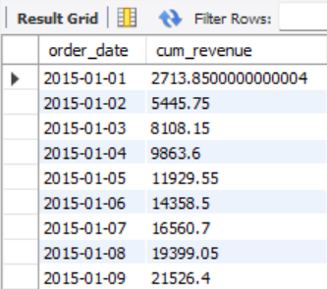
ANALYZE THE CUMULATIVE REVENUE GENERATED OVER TIME

Slide 16
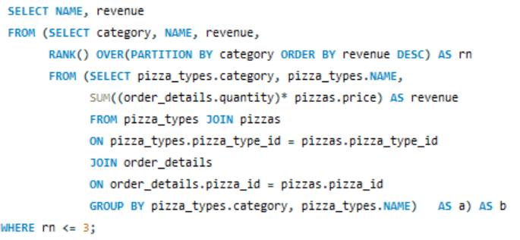
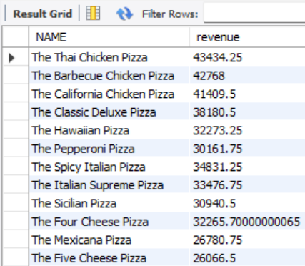
CALCULATE THE PERCENTAGE CONTRIBUTION OF EACH PIZZA TYPE TO TOTAL REVENUE

Slide 17
THANK YOU
FOR ATTENTION
LinkedIn Profile
GitHub Profile

